Slide 1
Static Data
Technical - Overview
Integration Team
February 2018

Slide 2
AGENDA
Overview
Web services
Samples

Slide 3
“
GPP can maintain Static data profiles in its own system and allows users to upload static data profiles in GPP via web services ”

Slide 4

Web services
Apply Changes Service
Load Profile Service
Profile Action Service
Profile List Service

Slide 5
APPLY CHANGES SERVICE
This service enables a Third Party Application to apply recent updates that were made to specific profiles.
The same functionality is accessible using the Apply Changes dialog box in the GPP user interface.
Processing
The profile IDs in the <profileIDs> tag are converted to cache IDs.
Related caches are evaluated
Invalid profile IDs are ignored
Changes are applied and the cache is refreshed for each valid profile ID.
A response is returned

Slide 6
Load Profile Service
The service enables a third party application to retrieve a single entry per profile by providing both the profile unique ID and the entry unique ID .
Processing
The input parameters are validated.
Profile query is generated.
All relevant attributes are returned.

Slide 7
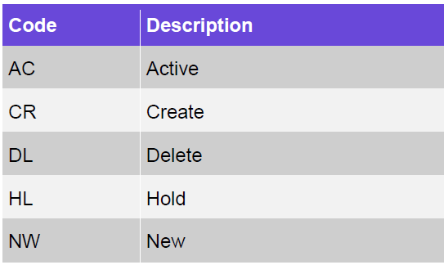
Profile Actions Service
This service enables a third party application to perform different actions on a static data profile, such as Save, Hold, Delete and Activate.
These action buttons are taken from GPP user interface.
Processing
The input parameters are validated. When the profile ID cannot be found or is not provided, an error is generated.
The list of applicable profile IDs is defined in the system (MENU_ITEMS.ITEM_ID).
Profile query is generated.
These are valid statuses (selection from system table FIELDS_VALUES with FIELD_TYPE = 'REC_STAT’).

Slide 8
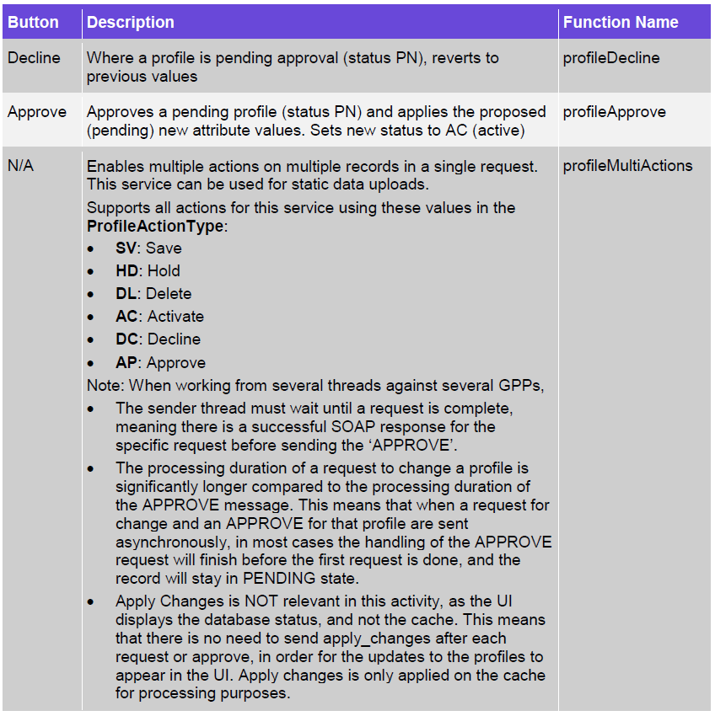
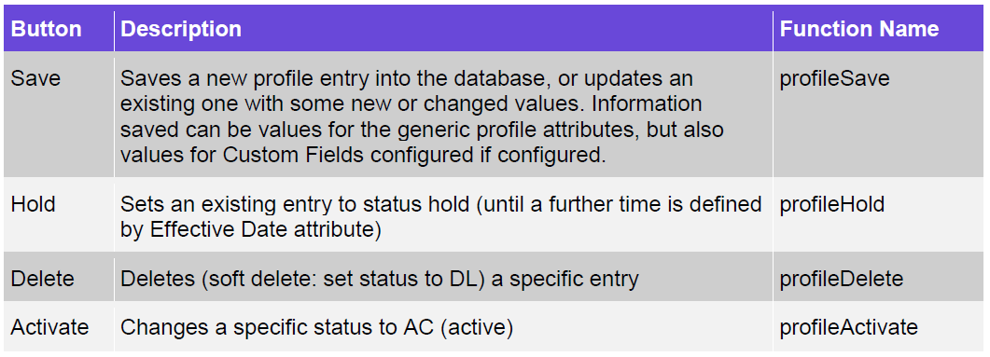
Profile Actions Service - function
This table includes the important functions (Static Data Actions) support by this service.

Slide 9
Profile list Service
The Get Profile List service enables a third party application to retrieve any related reference data (also known as profiles in GPP) by providing a set of query criteria. The service assesses the relevant selected profile and returns the matching results. For example, from the Parties profile, get a list of parties (BIC, party name and address) where BIC is like ’FNDTGB22%’. The service response would be all entries from the Parties profiles that meet this search criterion.
Processing
The input parameters are validated. When the profile ID cannot be found or is not provided, an error is generated.
Required columns are checked. If a column is not found in the database, it is ignored and a relevant log entry is made in nonExistCols.
Profile query is generated.
Results are returned

Slide 10
Examples summary
Service | Request | Response
Apply Changes Service
Load Profile Service
Profile Action Service
Profile List Service

Slide 11
Thank you
Arnab Podder
Integration Team
alexander.perman@finastra.com

